Slide 1
Mohamed Assem presentation
HR Attrition Project
Tel:01229510364
Email: assemmohamed331@gmail.com
LinkedIn: https://www.linkedin.com/in/mohamed-assem-671934363/
First:- we design our dashboard to optimize visualize and reduce time loading .
Second :- we share our dashboard as embedded in power point
You can navigate between page by buttons on name of page.
Third:- we show the detection of outliers
Fourth:- talk about data modeling and star schema
Fifth:- check the .doc for storytelling and take a best decision

Slide 2

Home Page

Slide 3
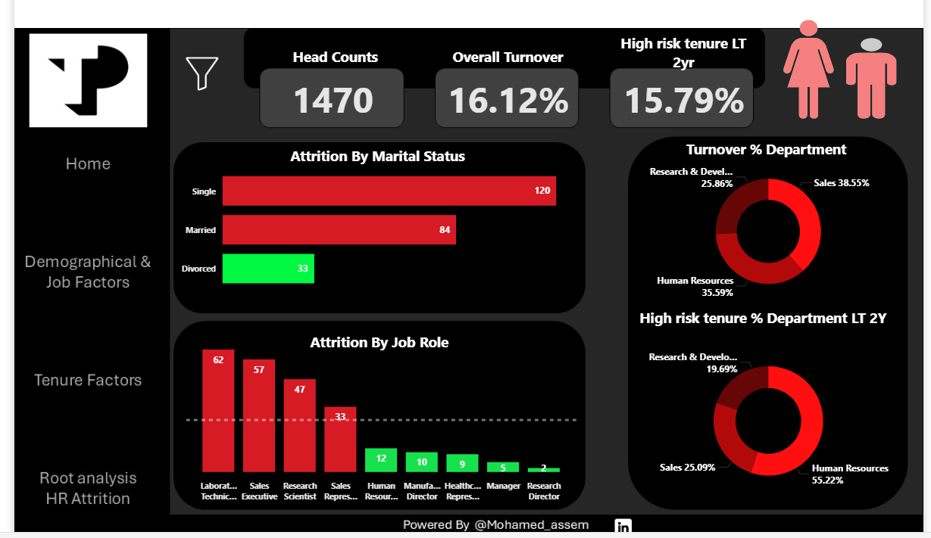
Demographical and Job Factors

Slide 4
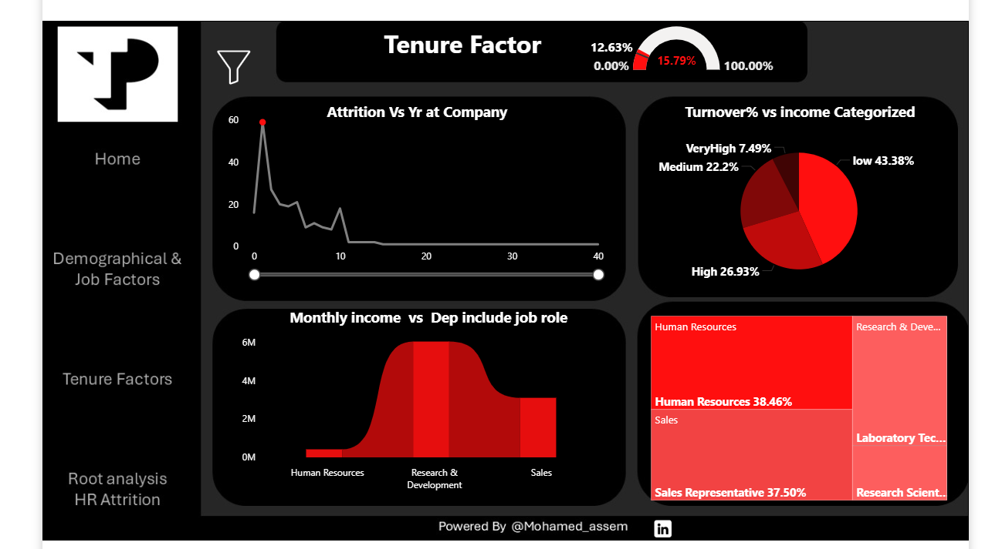
Tenure Factor

Slide 5
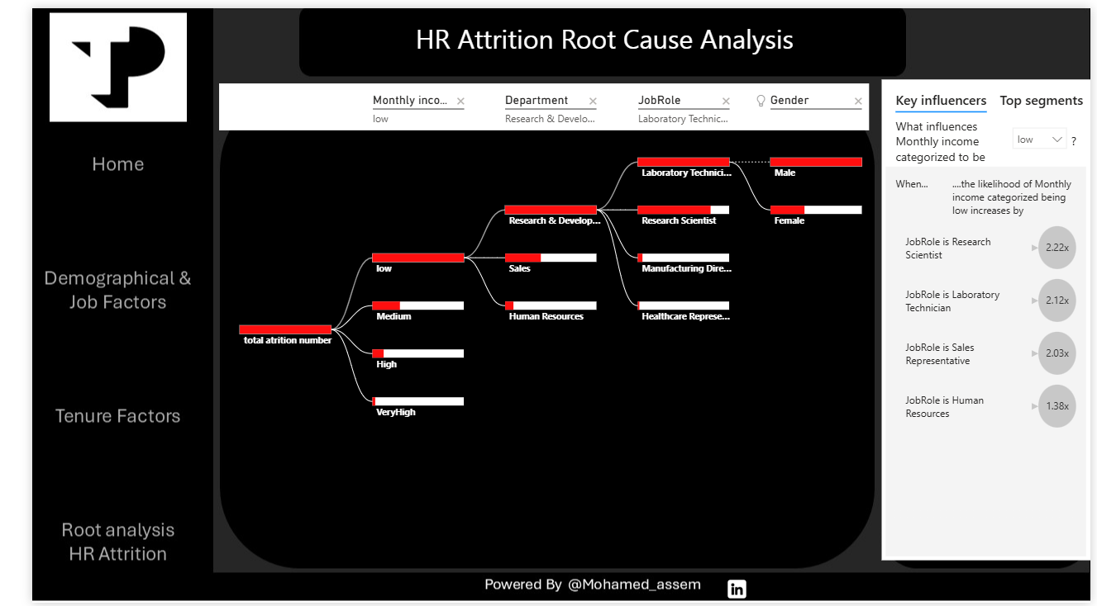
HR Attrition Root cause

Slide 6
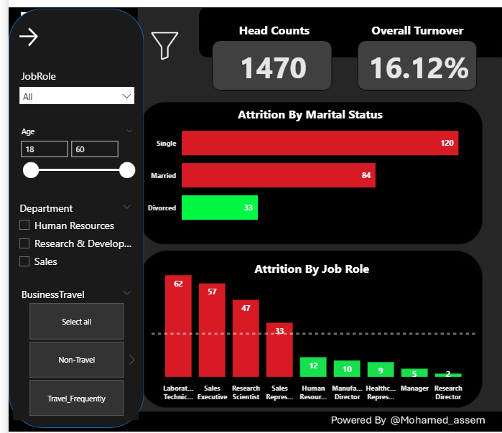
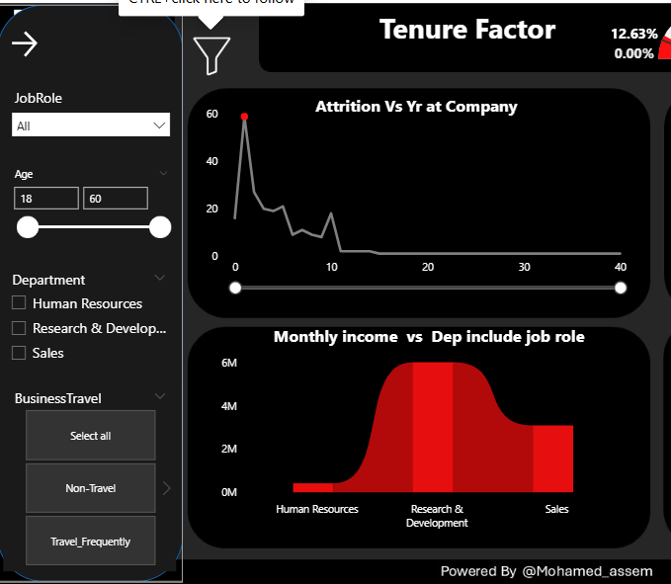
Build filter by bookmarks

Slide 7
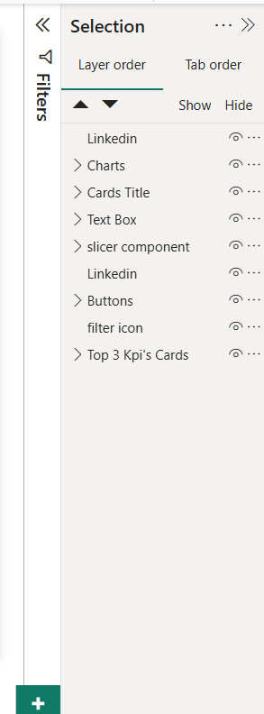
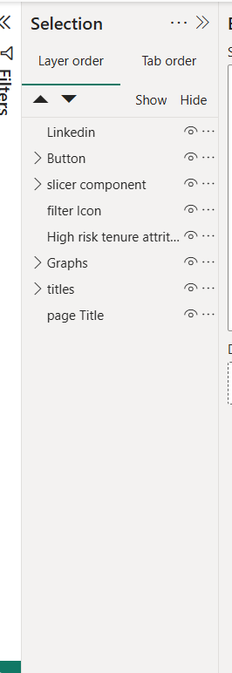
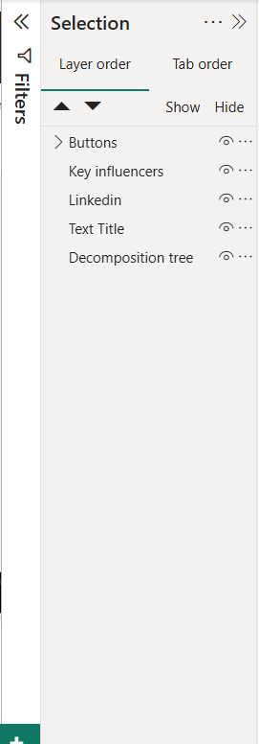
Organize selection pane for team work

Slide 8
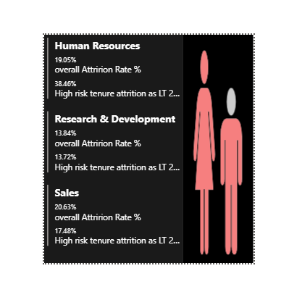
Tool TIP

Slide 9
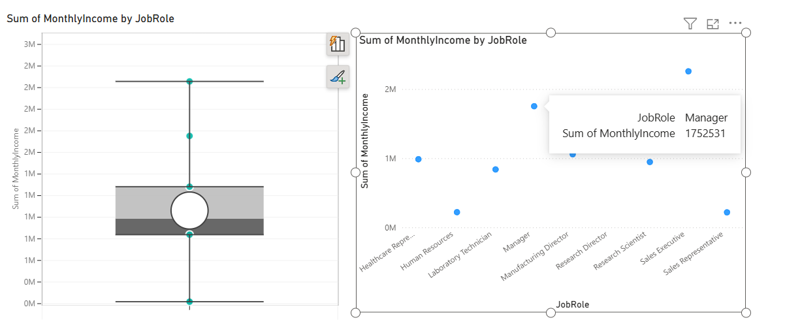


Outliers detection
Most efficiance way to detect outliers is use Box Plot and also scatter plot
Sales executive : 2257315$
Next
Managers : 1752531$
They can defect on average if we will let them with us we should we’ll focus on median salary not average

Slide 10

Live connection of dashboard you can use buttons to navigate between pages

Slide 11
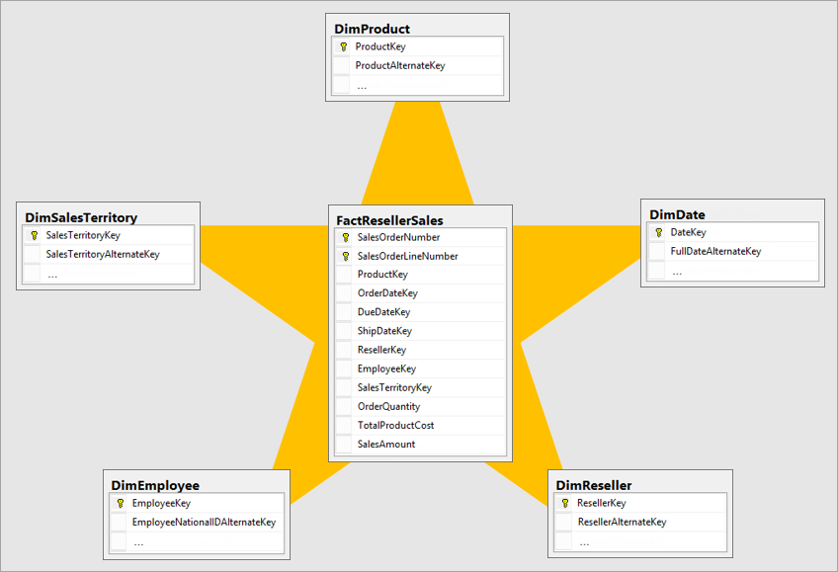
Data modeling and star schema
Just about star schema you give me HR as one department I don’t have many sheets
To made a fact tables
And dimension tables for each department
And we don’t have primary keys
And Foreign Keys

Slide 12
Thank You
Happy Day

